Slide 1
LatentView Analytics Case Study
17-02-2021

Slide 2
Business Context & Objective
Business Context & Objective
The Client’s Marketing team has conducted a High-level Audit and Data analysis in SFDC and Pardot. This analysis highlighted the data discrepancy across salesforce & Pardot, making it difficult to contact potential customers and take-action.
The Client plans to mitigate this Risk in terms of Data relevancy issue as well as Missed opportunity to enable a more targeted & systematic contact engagement.
The initial 4 Month project with the Client is aimed at implementing a Unified Customer View (SCV) reconciling between SFDC & Pardot by performing a Data Cleanse of the client’s CRM and an enabling a Data Governance Structure for monitoring data health and quality in future.
In addition, building we aim to build key Customer Segments on top of the SCV by building marketing KPI for digital and sales channels.
By Executing this Initiative, it provides opportunity to expand the scope for analytics initiatives such as opportunity identification & identifying leads with high propensity to invest.

Slide 3
Understanding BMO’s Analytics Maturity
3
4
1
2
Drive & adopt change
Stakeholders can drive adoption and change management globally. There is a general willingness to adopt solutions
Siloed decision making within a region / channel using the data that is accessible/ available. Data available is not consistant through the org
Analysis and Decisioning
Data and tools management
They do not have a central data hub and are unsure of how data is being collected. Data collected is not effectively leveraged.
Skills & Process management
The in-house teams are not well versed with data skills. Business processes are not uniform through out the Organisation and there is a lack of know-how surrounding data capture
Advanced Marketing Operations *
Integrated Marketing Operations
Intermediate….
Foundational *….
In our assessment Client’s capabilities are at Foundational level

Slide 4




Single Client View Journey
A leading UK based Asset Management firm wanted to clean their existing CRM in order to enable a more targeted & systematic contact engagement
Single Customer View
Building a Unified Customer View by reconciling data from different sources and enabling Enable targeted marketing on specific customer segments
Data Audit
Identify Characteristics and key fields to establish a clean CRM
04
01
Data Governance
Build a data governance framework that can help monitor change management
Data Cleanse
Build a clean CRM by establishing a global nomenclature for Key Fields across organization
03
02
Notes:
Warranty claim predictions were based on an historical average computed across all categories of drivers
Driving styles were identified based on vehicle usage and historical warranty claims which were then used to accurately predict future claims for each driving style
Warranty costs reduced by 35% for the “long pause and short trips” driving style due to proactive ‘drive right’ messaging communicated to at-risk drivers
LatentView Solution:
Driving Styles
Identify key driving styles using the vehicle controller data
What are the main driving styles?
Warranty Claims
Compare driving styles with warranty claims data
Are there claim patterns to individual styles?
Automated Hypothesis Testing
Use the tool to identify risk groups by dynamic profiling
Continuous Hypothesis Testing
Process:
Data collected:
1) Vehicle Usage from Connected Data - Driving Styles
2) Warranty & Repair Data - Repairs & Risk Patterns
Output:
Driver Segmentation, Risk Prediction & Maintenance at each Car (VIN) level

Slide 5
1.Data Audit Overview
01
02
03
What/Why?
How?
Impact
Understand the process of activity tracking in different objects and relationships among them
Perform a detailed data audit on all the fields in Salesforce & Pardot
Understand distribution, skew, and categorical frequency for each field. Formulate a roadmap for cleaning data
Client primarily uses Salesforce and Pardot for collecting digital CRM data
LatentView’s first step towards the Client’s data driven transformation was to understand their data thoroughly, through a detailed data audit.
Identified the initial set of 50 key fields that would be the central focus of cleanse and governance efforts.
Notes:
Business Objective:
Help identify signals that influence the whole user search experience and also increase the user engagement on client’s search engine
LatentView Solution:
LatentView’s Panel Miner solution was applied to convert unstructured HTML data to structured tabular data
LV’s seamless data processing pipeline is composed of ETL operations followed by Hadoop processing and finally migration to database for storage and reporting
Over 300 GB per week of data is hosted in AWS cloud environment
Web dashboards and automated Excel reports were built for reporting of outputs
Business Benefit:
Weekly reports on the feature coverage, feature distribution, CTR(Click Through Rates) of search result pages along with competition to benchmark key performance differentiators
Weekly news flash on new features introduced by competition, their Ad footprint to measure key performance indicators such as ad density, ad impression yield that can influence decisions taken by Product Planning Group.
Deep dive analysis of Click Stream data to infer users position in purchase funnel and thereby identify signals
Selected for Presentation in AWS Re-Invent-2014
For 4.5M searches per month, with 12% of them clicking through to brokerage sites, assuming an ad revenue of $1 - $6 per click, potential monetization benefit realized is between $3M to $18M annually

Slide 6
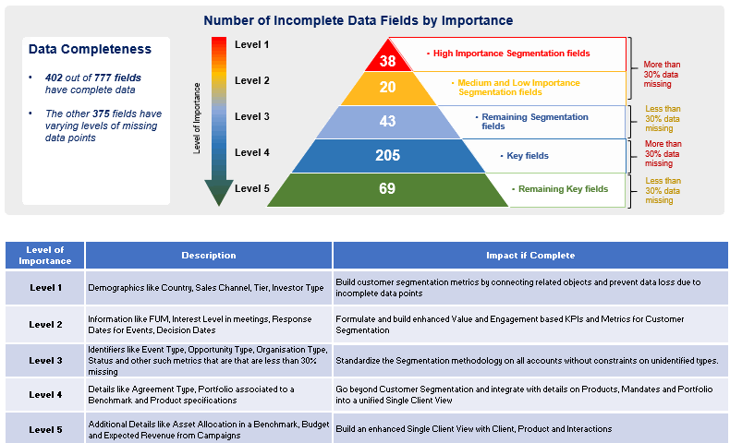
Data Audit Summary & Findings
Identified key fields and prioritized them based on importance for data cleanse

Slide 7
2. Data Cleanse Overview
01
02
03
What/Why?
How?
Impact
Developed and proposed a global nomenclature to be followed across the organization and got signed off by the business
Implemented the proposed mapping to clean the CRM data.
Performed a three phase UAT testing with unseen business users before rolling out to production.
Clean data pushed to Salesforce to streamline with regular use.
Cleaned digital CRM data with a global nomenclature for Region, Channel and Investor Type to help standardize data across the organization.
We built reports that helped in easier transition and User adoption to the established nomenclature.
Out of the observed 50 key fields, we identified Region, Channel and Investor Type as the fields quintessential for business and discovered gaps and inconsistency in them.
Notes:
Business Objective:
Help identify signals that influence the whole user search experience and also increase the user engagement on client’s search engine
LatentView Solution:
LatentView’s Panel Miner solution was applied to convert unstructured HTML data to structured tabular data
LV’s seamless data processing pipeline is composed of ETL operations followed by Hadoop processing and finally migration to database for storage and reporting
Over 300 GB per week of data is hosted in AWS cloud environment
Web dashboards and automated Excel reports were built for reporting of outputs
Business Benefit:
Weekly reports on the feature coverage, feature distribution, CTR(Click Through Rates) of search result pages along with competition to benchmark key performance differentiators
Weekly news flash on new features introduced by competition, their Ad footprint to measure key performance indicators such as ad density, ad impression yield that can influence decisions taken by Product Planning Group.
Deep dive analysis of Click Stream data to infer users position in purchase funnel and thereby identify signals
Selected for Presentation in AWS Re-Invent-2014
For 4.5M searches per month, with 12% of them clicking through to brokerage sites, assuming an ad revenue of $1 - $6 per click, potential monetization benefit realized is between $3M to $18M annually

Slide 8
3. Data Governance
01
02
02
03
01
03
What/Why?
How?
Impact
Broad categorization across Business groups was adopted as a part of the data cleanse, however, record level data gaps required business inputs and some of these required a process change at a Regional Level.
Moreover, Clients required a governance system to be established in order to track the health of core objects and its fields in the CRM
LatentView’s data governance framework and dashboard helped the client Leadership in monitoring change management in real-time to enforce globally standardized data processes.
Smoothened the process of data cleanse.
One of the major Business groups adopted a major data cleanse process based on the insights shared .
.
A data governance dashboard, tracking the health of the core objects and its fields was built with the following set of views:
Sales Audit View for Senior Leadership
Core information(Health Tracker for core fields in CRM) for Regional Sales heads
Data Gaps/ Inconsistences for Regional Sales heads
Notes:
Business Objective:
Help identify signals that influence the whole user search experience and also increase the user engagement on client’s search engine
LatentView Solution:
LatentView’s Panel Miner solution was applied to convert unstructured HTML data to structured tabular data
LV’s seamless data processing pipeline is composed of ETL operations followed by Hadoop processing and finally migration to database for storage and reporting
Over 300 GB per week of data is hosted in AWS cloud environment
Web dashboards and automated Excel reports were built for reporting of outputs
Business Benefit:
Weekly reports on the feature coverage, feature distribution, CTR(Click Through Rates) of search result pages along with competition to benchmark key performance differentiators
Weekly news flash on new features introduced by competition, their Ad footprint to measure key performance indicators such as ad density, ad impression yield that can influence decisions taken by Product Planning Group.
Deep dive analysis of Click Stream data to infer users position in purchase funnel and thereby identify signals
Selected for Presentation in AWS Re-Invent-2014
For 4.5M searches per month, with 12% of them clicking through to brokerage sites, assuming an ad revenue of $1 - $6 per click, potential monetization benefit realized is between $3M to $18M annually

Slide 9
4. Single Customer View
01
02
03
What/Why?
How?
Impact
Built reports on Engagement touchpoints as a dashboard with views to cater to 3 leadership levels :
Global Distribution & Marketing heads
Regional Marketing Managers
Relationship Managers
Enabled targeted marketing on specific customer segments based on Personal and Digital touchpoints.
Track key engagement touchpoints and segment customers based on their engagement activity by reconciling their data from CRM(Salesforce) and marketing automation tool (Pardot)
Segmented the customers based on their engagement through digital and personal touchpoints and provided a rule- based recommendation for tiering.
The clients had limited sales bandwidth and were looking for a more targeted approach. Building a single customer coupled with customer segmentation based on engagement behavior enabled tracking customer journey and prioritize marketing efforts using an Engagement Index.
Notes:
Business Objective:
Help identify signals that influence the whole user search experience and also increase the user engagement on client’s search engine
LatentView Solution:
LatentView’s Panel Miner solution was applied to convert unstructured HTML data to structured tabular data
LV’s seamless data processing pipeline is composed of ETL operations followed by Hadoop processing and finally migration to database for storage and reporting
Over 300 GB per week of data is hosted in AWS cloud environment
Web dashboards and automated Excel reports were built for reporting of outputs
Business Benefit:
Weekly reports on the feature coverage, feature distribution, CTR(Click Through Rates) of search result pages along with competition to benchmark key performance differentiators
Weekly news flash on new features introduced by competition, their Ad footprint to measure key performance indicators such as ad density, ad impression yield that can influence decisions taken by Product Planning Group.
Deep dive analysis of Click Stream data to infer users position in purchase funnel and thereby identify signals
Selected for Presentation in AWS Re-Invent-2014
For 4.5M searches per month, with 12% of them clicking through to brokerage sites, assuming an ad revenue of $1 - $6 per click, potential monetization benefit realized is between $3M to $18M annually

